Slide 1
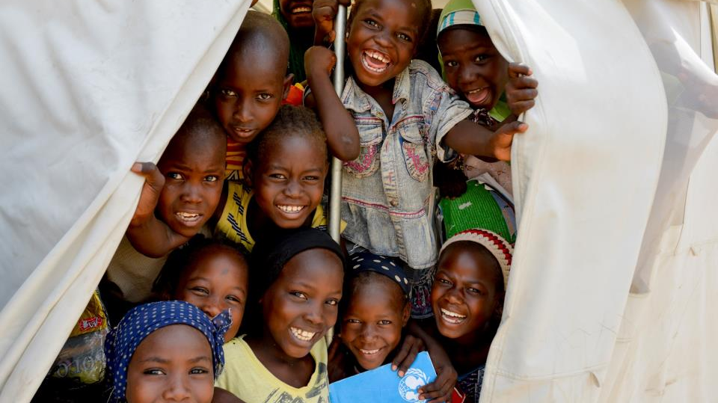


Let Us Learn Madagascar:
An Integrated Program for Adolescent Girls
Notes:
Good morning/afternoon/evening, my name is _____ and I serve as _____
Thank you for having me here to discuss the 2016-2018 biennium project in partnership with the U.S. Fund for UNICEF, Let Us Learn Madagascar
Today we will delve deeper into this partnership and the impact it will have on girls in Madagascar, focusing on:
Background on UNICEF and work around the world to support the well-being of women and children
The history of partnership between Zonta and the U.S. Fund for UNICEF
The situation for children in Madagascar, how Let Us Learn will improve lives and opportunities, and why this project is so important
Why your support matters and some tools for fundraising

Slide 2
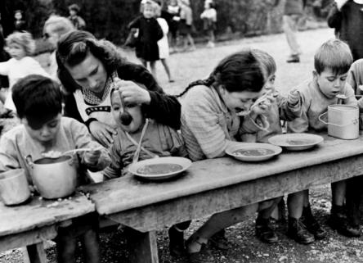
UNICEF
To advocate for the protection of children’s rights, to help meet their basic needs, and to expand their opportunities to reach their full potential.
UNICEF was founded in 1946 to help children in the aftermath of World War II. UNICEF’s mandate was extended indefinitely in 1953.
Notes:
Does anyone know what UNICEF stands for?
UNICEF was founded in 1946 by the United Nations to meet the emergency needs of children in post-war Europe and China. (United Nations International Children’s Emergency Fund)
In 1950, its mandate was broadened to address the long-term needs of children and women in developing countries everywhere. (became United Nations Children’s Fund- but the acronym stuck!)
UNICEF insists that the survival, protection and development of children are universal development imperatives that are integral to human progress.
Further- UNICEF aims, through its country programs, to promote the equal rights of women and girls and to support their full participation in the political, social, and economic development of their communities.

Slide 3
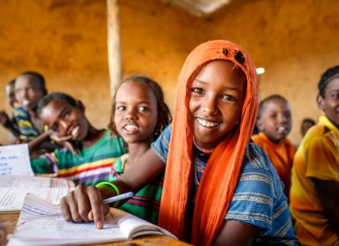
U.S. Fund for UNICEF
The U.S. Fund for UNICEF secures crucial private financial support, advocates for government funding for UNICEF, and is dedicated to increasing the engagement of all Americans who care about the well-being of children. Our vision is a better world for children everywhere.
Notes:
The U.S. Fund for UNICEF is one of 35 national committees. UNICEF National Committees advocate for children, and raise funds and public awareness to help UNICEF reach the world’s most vulnerable children and their families.
We work with partners like Zonta (because Zonta is headquartered in the U.S.) to achieve progress for children by empowering our partners and supporters to raise funds for UNICEF and be a voice for children locally and globally.

Slide 4
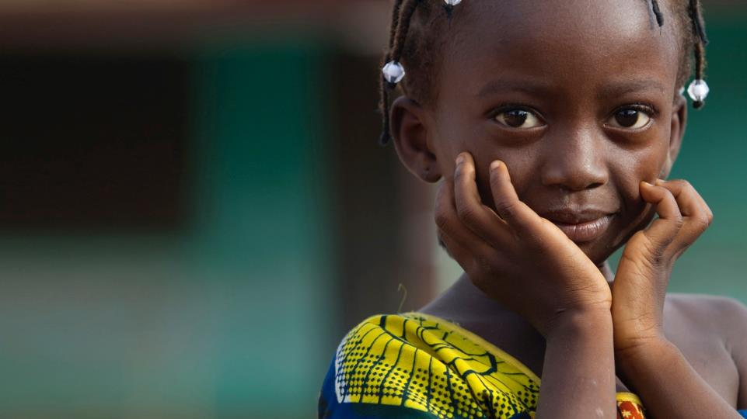



Wherever the poorest children are…
wherever the most vulnerable children are…
wherever the forgotten children are…
that is where we must also be —
in even greater measure.”
Anthony Lake
Executive Director of UNICEF
Notes:
Human Rights:
UNICEF’s work is guided by a human rights-based approach and an equity-based strategy.
Every child has a right to a healthy, safe, productive life. UNICEF is the only agency given an explicit mandate by name in the Convention on the Rights of the Child (1989).
Equity is achieved when all children have the same opportunity to survive, develop, and reach their full potential without bias or favoritism.
(give example of equity of kids standing on boxes)
Why Equity?
The equity approach is consistent with the CRC as a means to address the root causes of inequity so that all children have access to services necessary for their survival, growth and development.
UNICEF therefore targets its work particularly among the most vulnerable and marginalized – that is, girls, children who have been orphaned, those who live in remote settings, urban slums, are living with HIV/AIDS, are living with a disability, children of ethnic minority groups, and other marginalized, disadvantaged and hard-to-reach populations.
UNICEF has saved more children's lives than any other humanitarian organization in the world.
Yet, every day, more than 16,000 children under five die — and they don’t have to. They die from causes most people in the U.S. rarely worry about. Malnutrition. Unsafe drinking water. Lack of a fifteen-cent vaccine.
UNICEF is at the forefront of efforts to reduce child mortality worldwide and already, there has been substantial progress: So far, the annual number of under-five deaths has dropped by 53%, from 13 million in 1990 to 6 million in 2015 and this number continues to decrease faster than at any other time during the past two decades. 91% of the global population used an improved drinking water source and 68% used an improved sanitation facility; and there has been a 41% reduction in stunting rate since 1990.
However, much remains to be done…

Slide 5


UNICEF Strategic Plan (2014-2017)
Survive from Arrival
to Thrive into Adulthood
OUTCOME AREAS
Health
HIV & AIDS
WASH
Nutrition
Education
Child protection
Social inclusion
CROSS-CUTTING AREAS
Gender
Humanitarian Action
Survive Thrive
Notes:
UNICEF’s strategic plan (2014-2017) utilizes a human rights and equity-based approach to scale up proven interventions that will save and protect all children -- especially the most disadvantaged.
UNICEF’s work is planned and carried out across seven core outcome areas and two cross-cutting areas in over 150 countries.
Examples of UNICEF’s programmatic work:
Health: UNICEF works to improve children’s health increasingly focused on newborn health in the first month of life, based on the finding that around 4544 percent of under-five deaths occur during the neonatal period. Pneumonia, diarrhea and malaria cause the majority of under-five deaths, most of which are preventable with proven, low-cost interventions.
HIV/AIDS and children: UNICEF and its partners are working to achieve an AIDS-free generation - a generation in which children are born free of HIV and remain so for the first two decades of life, and in which children living with HIV have access to treatment and care, allowing them to survive and thrive.
Water, Sanitation & Hygiene: 32 percent of the world’s population, or 2.4 billion people, lack improved sanitation facilities, and 663 million people use unsafe drinking water sources. Lack of clean water and sanitation facilities is the major force behind a variety of diseases which are deadly to small children. UNICEF works with governments, communities, community-based organizations and families to ensure that household have access to a clean and secure supply of water and convenient sanitary facilities. UNICEF also works to improve sanitation and hygiene in schools while educating on the importance of sanitation so that children themselves help improve sanitation in their homes and communities.
Nutrition: Undernutrition contributes to nearly half of all deaths in children under 5 and is especially widespread in Asia and Africa. The Scaling Up Nutrition (SUN) movement is a UN, governmental, non-governmental and private sector partnership to scale up interventions in countries affected by high rates of undernutrition – Tony Lake leads the Secretariat.
Education: UNICEF provides leadership and support on education policy and programs in 156 countries. UNICEF works in the two main areas of education: in the policy arena ('upstream'); and through direct support to the implementation of services ('downstream'). With partnership as a key principle and mode of operating, in each area UNICEF supports three main activity areas: advocacy; capacity-building; and service delivery. In doing so, UNICEF secures more commitments and resources for early learning programming; strengthens the evidence base for equitable policy development; advances policies and plans focusing on girls’ education and inclusive education, particularly for children with disabilities; improves learning assessment; and prepares for and responds to education needs in large-scale, complex emergencies. In 2014, 8.6 million children in humanitarian situations accessed formal or non-formal basic education with the help of UNICEF, an increase from 3.6 million in 2013.
Child Protection: UNICEF aims to protect children around the word from violence, exploitation, and abuse that can severely damage a child’s physical and mental health in the short and long term, negatively impacting their transition to a healthy adulthood. UNICEF’s work in child protection is shifting as governments are increasingly scoping out their child protection systems and prioritizing areas for strengthening. UNICEF helps governments identify the nature of their systems and areas requiring strengthening, assisting them to develop budgets, policy papers, and legislation and addresses bottlenecks and barriers to critical mechanisms such as birth registration.
Social Inclusion: This is a cross-cutting focus area that all of UNICEF’s policies and programs strive to achieve. Every child has the right to basic social safety nets to ensure her or his needs are met in the areas of housing, food, clean water and sanitation, access to a quality education, and access to safe spaces to play and grow and develop to reach their full potential. Focusing on those who are most marginalized and vulnerable is the most effective, cost-efficient way to achieve targets across UNICEF’s 6 other focus areas.
Gender Equality: UNICEF’s work in the seven outcome areas is also cross-cutting from a gender equality and women’s empowerment angle, with equity being a main driver -- from health, education, child protection, nutrition, and beyond -- to ensure that every girl can live a healthy and productive life, free from violence, exploitation and abuse, and with the tools to realize her full potential. UNICEF’s gender action plan is focused on 4 pillars: (1) girls adolescent health; (2) ending child marriage; (3) advancing girls’ access to secondary school education; and (4) addressing gender-based violence.

Slide 6
Zonta and the
U.S. Fund for UNICEF
A History of Support
Ghana
Colombia
Sri Lanka
Guatemala
Burkina Faso
Nepal
Afghanistan
Rwanda
Notes:
None of this work would be possible without the dedicate support of partners.
Zonta International and the U.S. Fund for UNICEF have a long history of partnership across many of these priority areas, resulting in thousands of saved and improved lives in countries including Ghana, Colombia, Sri Lanka, Burkina Faso, Afghanistan, and Rwanda.
A few examples of how this partnership has positively impacted lives:
Zonta began its support for UNICEF in 1972 by funding mobile medical units in hard to reach rural areas of Ghana. I’ve been to Ghana, and I’ve seen the reach of community-based health programs as a main source of basic maternal and child health care to this day, and these units planted the early seeds of this type of work.

Slide 7
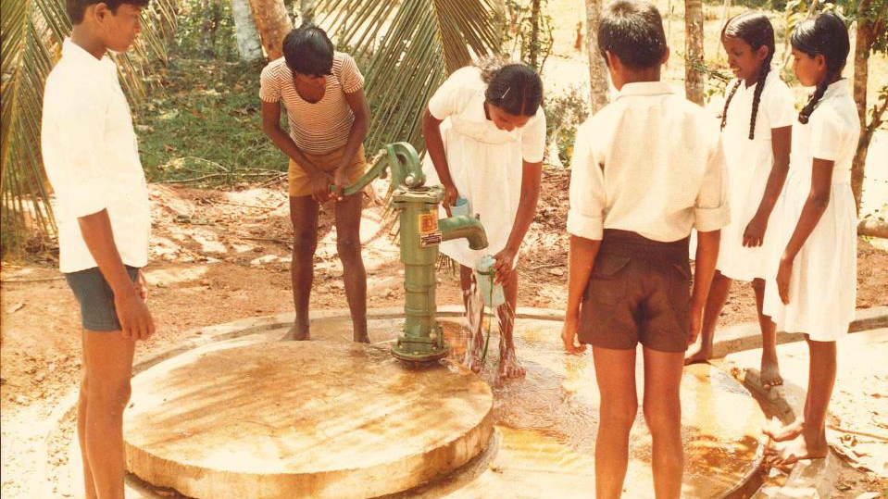
SRI LANKA
Notes:
In 1982, Zonta support UNICEF Sri Lanka to provide safe drinking water to 350,000 people in dry zones through a well water project.
768 million worldwide use unsafe water sources- you ensured that many families in Sri Lanka are not part of this statistic.

Slide 8
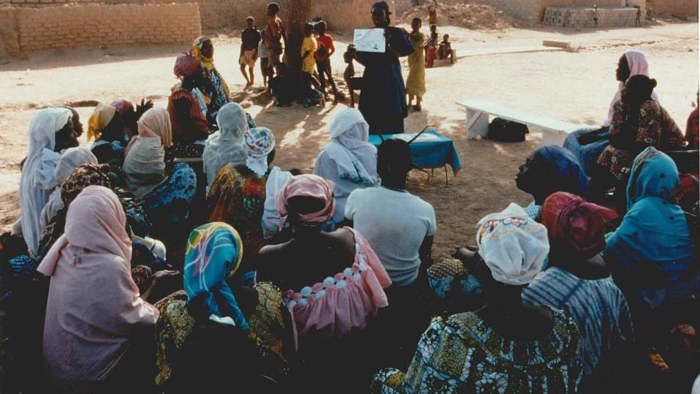
Sri Lanka
BURKINA FASO
Notes:
From 1998-2002, Zonta assisted UNICEF and partners in working to prevent the incidence of Female Genital Mutilation and Cutting. FGM/C is a practice with serious immediate and long-term health effects and is a clear violation of fundamental rights.
Thanks to the commitment of NGOs including Zonta International , by 2005 only 25% of girls in Burkina Faso underwent FGM/C, compared to 66.35% in 1996- a 40% decrease in less than a decade. Social norms and cultural practices are changing, and communities are united to protect the rights of girls. There continues to be widespread community mobilization to decrease support for this practice thanks to foundations laid by Zonta and other partners several decades ago.

Slide 9
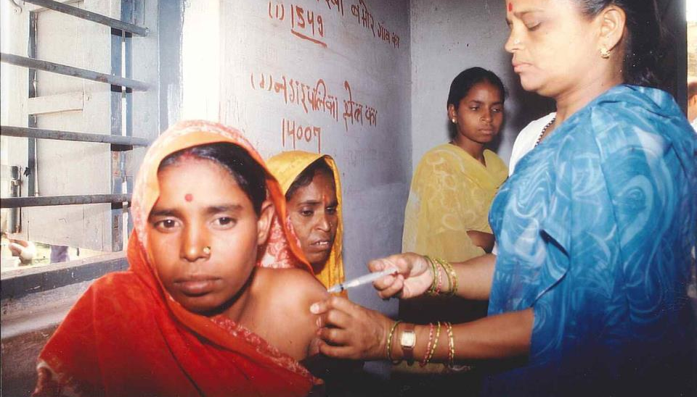
Sri Lanka
NEPAL
Notes:
Zontians also supported Maternal and Neonatal Tetanus elimination in Afghanistan and Nepal, a program that is now an integral part of UNICEF’s maternal and child survival goals.
Maternal and neonatal tetanus kills approximately 49,000 newborns and a significant number of mothers each year; these children die in excruciating pain, but they don’t have to.
Zonta’s support ensured that women of child-bearing age have access to a series of three immunizations to protect themselves and their babies, as well as learn safe birthing practices to prevent contraction of the disease and increase the availability of vital routine health services. UNICEF was able to target more than 200,000 women in Afghanistan and nearly 680,000 women in Nepal through Zonta’s support, and shortly thereafter, Nepal was declared free of MNT in December 2005.

Slide 10
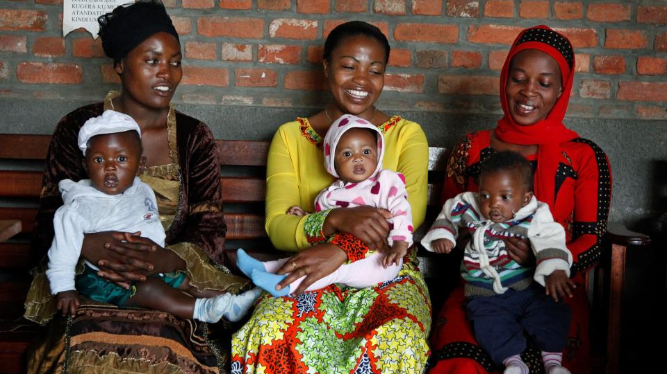
Sri Lanka
RWANDA
Notes:
And of course, most recently, Zonta’s commitment to support UNICEF Rwanda, from 2008 to 2016, resulted in extraordinary impact-
Mother-to-child transmission of HIV has been virtually ELIMINATED in Rwanda, and One Stop Centers addressing violence against women and children are now being scaled up across the country

Slide 11
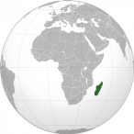

Let Us Learn Madagascar:
An Integrated Program for Adolescent Girls
Partnership in the 2016-2018 Biennium
Notes:
I shared these examples because they are evidence of the great success for women and children that Zonta and UNICEF have together.
We are poised to continue this trajectory with our 2016-2018 project partnership, Let Us Learn Madagascar
Let Us Learn Madagascar is an innovative program that focuses on mitigating the risk factors that prevent students from being enrolled or staying in school, while also creating an environment for quality education. The outcomes will focus on improving gender parity and access to education for vulnerable children, especially girls.

Slide 12
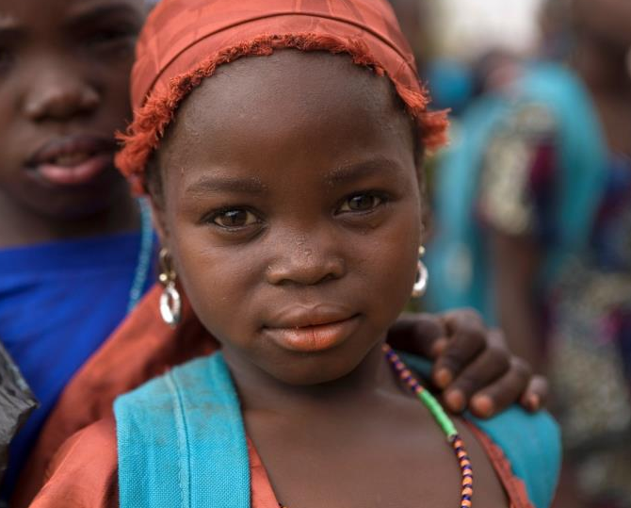
59 Million Not in Primary School
65 Million Not in Secondary School
Girls Marginalized
Focus on the
Most Vulnerable
Sri Lanka
Notes:
Why are we focusing on this program?
UNICEF has always operated in defense of the fact that every child has a right to education
Yet, children around the world continue to be denied this basic right due to challenges with access, lack of educational standards, and deeply ingrained inequities.
Globally:
59 million children are out of primary school
65 million adolescents are out of secondary school
Of children with the opportunity to attend school, 250 million still could not read or write
Girls are one of the most marginalized groups, with more than half being excluded from education. Most are children from remote areas and ethnic minorities.

Slide 13
Let Us Learn: Educating the Hardest to Reach
Lowest achievement in delivering education for children
Lowest quartile on the Human Development Index
High levels of out-of-school children
Severe equity issues
High susceptibility to natural disasters and conflict
Results: Afghanistan, Bangladesh, Liberia, Madagascar, Nepal
Notes:
UNICEF works in 156 countries to scale up access to quality education for the most marginalized children.
Yet, in some countries, challenges persist and traditional approaches to education were not making progress quickly enough.
UNICEF thought deeply about how to address inequities and focus resources for transformational outcomes for kids in the most challenging settings who are missing out an education. How? UNICEF looked at the most vulnerable countries using these criteria:
Lowest achievement in delivering education for children
Lowest quartile on the Human Development Index
High levels of out-of-school children
Severe equity issues
High susceptibility to natural disasters and conflict
Using this criteria, UNICEF found that Afghanistan, Bangladesh, Liberia, Madagascar, and Nepal represented key needs and opportunities to implement change through innovative programming

Slide 14
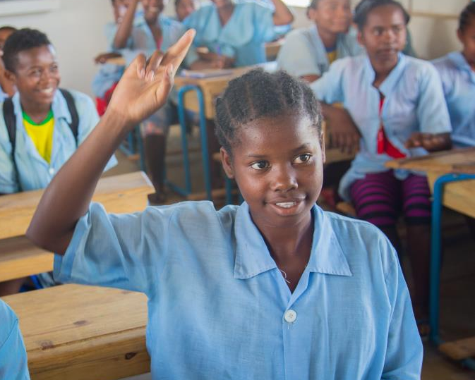
Reaching Out Of School Children
Expanding Girls’ Education
Improving Learning Outcomes
Sri Lanka
Notes:
Let Us Learn was born out of a desire to build innovative program to address the most challenging education circumstances. It was initiated in 2011 thanks to generous donor support, and champions the goal of “leaving no one behind,” with a special focus on girls, the largest group of children excluded from education.
This initiative is advancing equitable education through a focus on:
Reaching out-of-school children
Expanding girls’ education
Improving learning outcomes
UNICEF’s Let Us Learn program has already reached over 895,000 children to date with innovative and adaptive programs.
For example, Let Us Learn:
Provided 40,000 out of school children and adolescents in Bangladesh with pre-primary education and workforce training programs
Increased the core subject pass rates of nearly 80 percent of students enrolled in Liberia’s Let Us Learn program by 25 percent
Ensured access to basic education for over 9,000 out of school children in Afghanistan, 80 percent of whom are girls
In Madagascar, 72,000 children benefitted from improved school facilities

Slide 15
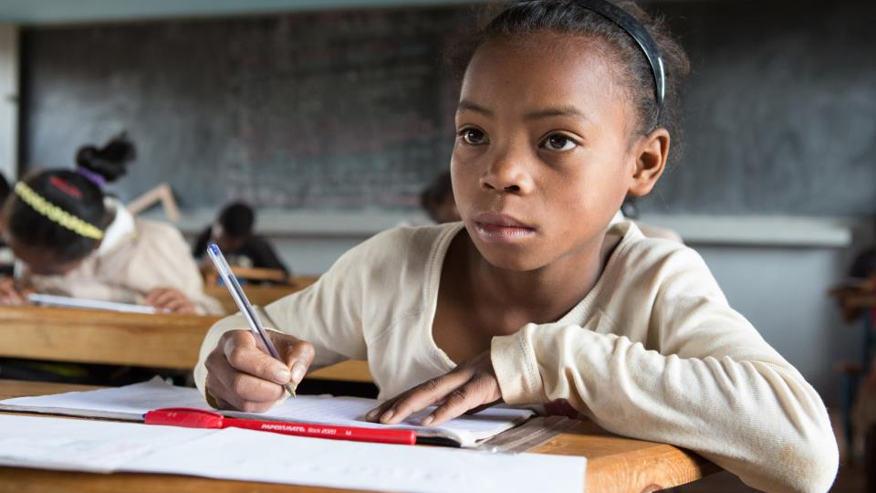
GIRLS’ EDUCATION BREAKS THE CYCLE OF POVERTY
Sri Lanka
Notes:
Why focus on girls’ education in particular? Education is truly a magic bullet in development.
Educating girls helps break the cycle of poverty:
educated women are less likely to marry early and against their will
less likely to die in childbirth
more likely to have healthy babies, and more like to send their own children to school
Just one additional year of education can increase a child’s earnings later in life by 10 percent!
Adolescent girls that attend school:
delay marriage and childbearing
are less vulnerable to disease (to put this in context, from 1970 to 2009 the world saw immense reductions in child mortality- an estimated 50 percent of this progress is linked to an increase in the education of girls and young women)
acquire knowledge and skills that lead to increased earning power

Slide 16
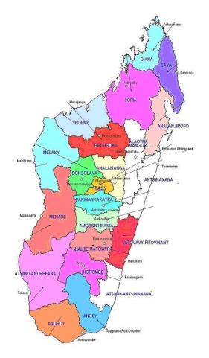
Madagascar
Island country off east coast of Africa
Population of 22 million; children under 18 make up 50%
History of political crisis
90% live on less than $2/day
Prone to natural disasters
Did not achieve any MDGs
All of these factors make children particularly vulnerable
Notes:
Let Us Learn is a unique program, in that it examines each country in its own context to understand the traditional and localized barriers to education that the most marginalized children are experiencing.
Let’s take a look at what these constraints are specific to Madagascar, and how Let Us Learn is poised to expand impact there should UNICEF Madagascar receive Zonta’s support.
ABOUT MADAGASCAR
Madagascar is an island country located off the east coast of Africa
The country gained independence in 1960, but has since struggled with political crises leading to prolonged instability, with detrimental impacts on the economy
As a result, currently about 90 percent of Madagascar lives on less than two dollars per day, leaving children particularly vulnerable
Madagascar is prone to natural disasters such as cyclones and locust infestations, which impede economic growth and make it even more difficult to break the cycle of poverty
Some of they key issues children face include malnutrition, access to clean water, delivery of quality social services, violence, early marriage, and harmful traditional practices.

Slide 17
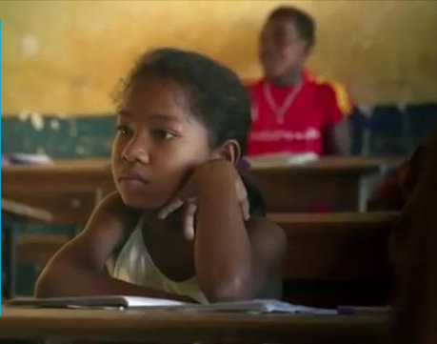
Meet Lantonirina
Notes:
Meet Lantonirina
I’ve just shared a lot of stats and words, but what does all of this actually mean for a girl in Madagascar?
Let me introduce you to Lantonirina. Some of you may have seen her story already from the video and I would encourage you to share her story when you present on Let Us Learn
Lantonirina is 11 years old and is from a small town called Mampikony. One day, she would like to become a teacher.
In order to do this, she already knows that she needs to continue her studies, but this is hard for her to imagine. Why does she already know this? Her mother, Lalao, stopped studying while in high school and got married. She and her family are forced to live in poverty, and she feels her circumstances would be different had she continued school. Her sister, Lalaina, had to stop going to school because her parents couldn’t afford it, and she also married young. She regrets it, and at age 17, she already has a toddler.
Lantonirina’s story is similar to many girls living in poverty in Madagascar, and before Let Us Learn, the odds would have been stacked against her.

Slide 18
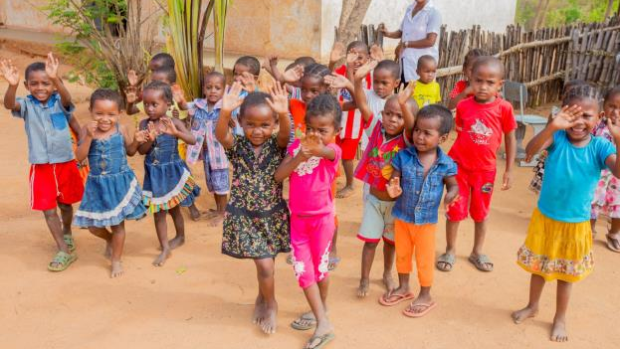
Context For Let Us Learn in Madagascar
Extreme Poverty
Education
Child Marriage
Sexual Violence
Lack Of Facilities
Notes:
SITUATION FOR CHILDREN
Why is Lantonirina in the situation she’s in? The education system in Madagascar has been severely hindered by extreme poverty. More than 15% of children are out of school, or 1.5 million, and although 7 out of 10 children reach the final year of primary school, only 3 out of 10 pass the national exam and the secondary enrollment rate is just 30 percent.
Children who do attend school receive a low quality education, school buildings have inadequate equipment and lack sufficient water and sanitation resources, and classroom sizes are overly large at crucial development phases.
The situation for girls magnifies these issues. More than one out of three girls will become pregnant before turning nineteen, and 41% are married before 18, making completing education a mere impossibility. 14% of girls experience sexual violence. Junior secondary school enrollment fees make education prohibitively expensive for families, or force parents to select only one child to continue their education, often leaving girls behind.
The same number of children are enrolling, but by graduation, we see gender parity reduced, with girls dropping out at faster rates.
More than 97 percent of teachers do not have any professional teaching diploma, which contributes to high repetition rates. Violence in school is also affecting drop out rates.

Slide 19
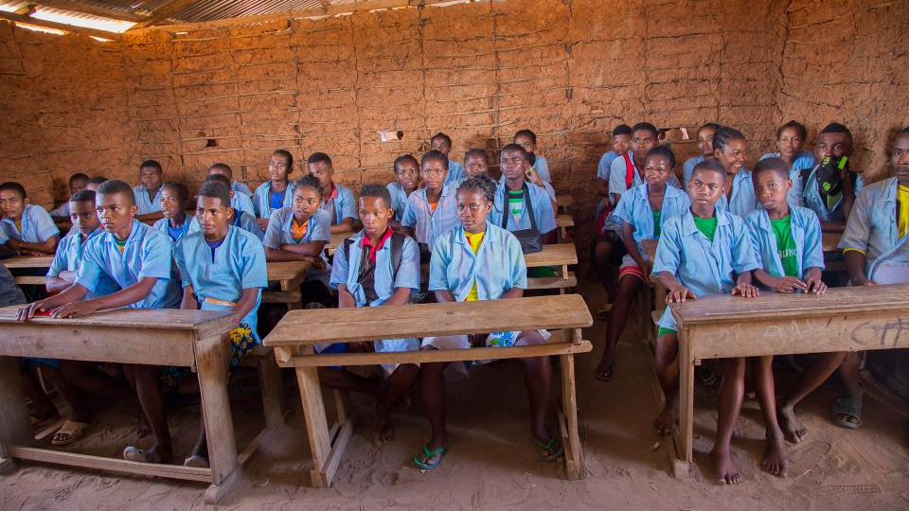
Gender Parity
Notes:
Despite these stark statistics, however, there is hope for progress.
Let Us Learn Madagascar, initiated in 2011, is the nation’s only program focused on achieving gender parity at the post-primary school level where drop-out rates for girls are the highest, and is already achieving results for children and adolescents.

Slide 20
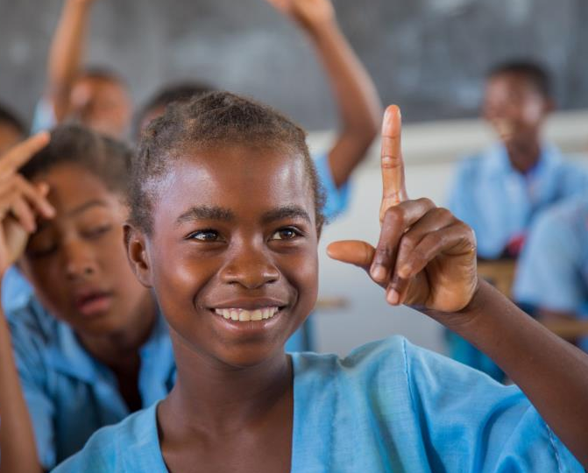
Access
Transition
Retention
Quality
Capacity Building
Sri Lanka
Notes:
The Let Us Learn program in Madagascar tries to address exclusion and low transition rates from primary to secondary through catch-up classes, cash transfers and material support. This equity approach encourages the continuation of studies, which will significantly reduce levels of poverty.
With Zonta’s support, Let Us Learn Madagascar will expand to a second phase, in two new regions, Androy and Anosy.
The Integrated Program for Adolescent Girls, which will be supported by Zonta International, is a retention and prevention strategy that creates opportunities for vulnerable and excluded girls to realize their rights to an education in a secure and protected environment.
This program, integrating effective strategies from across sectors including education, water, sanitation and hygiene, child protection, communication for development, and social protection, will have long-term effect by focusing on both direct education components and on other factors that impact enrollment and completion.
Why? Education is about much more than building a classroom or providing school supplies. This program will not only provide that support, but it will also work to mitigate the risk factors that pose barriers to access and quality- a truly integrated approach to paving the way for a productive education.

Slide 21
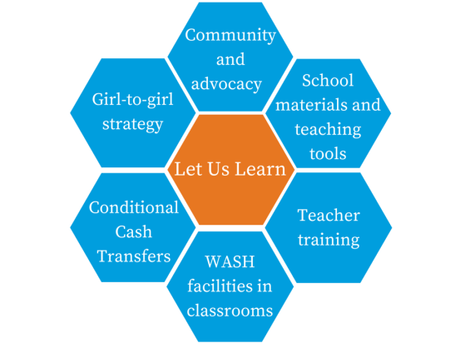

Program Components
Notes:
The second phase of LUL in Madagascar will continue to incorporate sustainable and scalable solutions, in an impoverished part of the country that is impacted consistently by severe drought. In an effort to help disadvantaged rural girls bridge the gap between primary and secondary school, when girls are most likely to drop out in Madagascar due to financial and cultural barriers, UNICEF will take a multi-pronged approach.
Program components will include:
The Girl-to-Girl strategy: targeting girls in the 5th grade who will receive peer support from girls in the 7th grade to facilitate their transition to junior secondary school
A refined social protection policy in partnership with the Government to offer Unconditional/Conditional Cash Transfers to families.
These transfers, which have been hugely successful in developing countries around the world, will be offered to vulnerable households as a resilience measure to mitigate negative coping mechanisms to poverty that are preventing children from attending school
This program is based on the premise that low-income families will receive this transfer to support their economic development and provide the ability to meet basic needs. Transfers will be monitored, including for connected to education components:
school enrollment
passing grades and minimum days of absenteeism, simultaneously ensuring:
girls are in school
reducing poverty-linked barriers to education
We must remember: A hungry child cannot concentrate in school! Access to food and water for pregnant mothers and children in the first 1,000 days will reduce stunting and so improve long-term physical and cognitive development; impacts long-term positive effects of education.
Further, these transfers are given to the female head of the household, increasing a woman’s decision-making capabilities. Evidence from other cash transfers programs demonstrates strongly that when women have this decision-making power, they overwhelmingly use this support for the survival, health, nutrition and education needs of their children.
The implementation of WASH in schools with:
The construction of classrooms with water points and latrines
ensuring that healthy habits are taught, practiced and integrated into daily school routines (provision of water filter systems in schools, teaching children low-cost methods of home water purification; teaching children to use latrines and keep them clean; teaching handwashing)- can tell how I saw this in Ghana
All school construction will also include the provision of school materials such as
School furniture
Learning materials
A sports field
Teacher training and peer support through teacher networks (hugely important based on the stat I shared previously)
Community level programs and advocacy campaigns focused on:
curbing child marriage and sexual violence
ensuring that families and communities are aware of:
child protection laws
Services available for victims of abuse
harmful practices/violent against children and how to prevent it
that they exhibit behaviors that are protective of the girl child

Slide 22
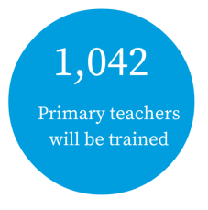
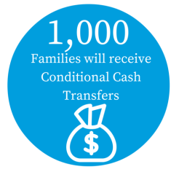
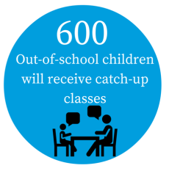
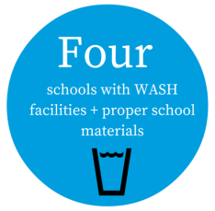
Results by 2018
Notes:
With Zonta International’s support, UNICEF Madagascar would be able to achieve the following results by 2018:
1,042 post primary teachers will be trained- imagine how many children will be impacted by this many teachers with improved skills in their classrooms!
600 students who have been out of school will receive catch-up classes
1,000 families will receive Cash Transfers, enabling them to send their children to school
Four schools will be constructed with appropriate water and latrine facilities and all children will be provided with proper school furniture, materials, and recreational spaces
In addition:
school codes of conduct will be established with school representatives to prevent violence and discrimination against children including young mothers
awareness raising programs focused on child rights will be implemented; teacher networks will be developed
Continuous monitoring and evaluation of the program will take place to ensure sustainable results.

Slide 23
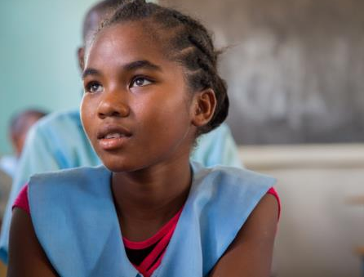
Target Outcomes
Increased transition rate
Gender parity
Decreased student to classroom ratio
Decreased percentage of repeaters
Increased knowledge of protection services
Increased retention of young mothers
Notes:
Thanks to the support we will receive from Zonta over the next two years, we are working towards the achievement of the following outcomes:
Increased transition rate from primary to junior secondary school (for both boys and girls, since our goal is gender parity!)
Gender parity at the lower secondary level
Decreased students to classroom ratio in public lower secondary
Decreased percentage of repeaters in public lower secondary
Increased percentage of adolescent girls’ knowledge of protection services available to them
Increased percentage of young adolescent mothers who stay in school and complete secondary school

Slide 24
Notes:
As Foundation Ambassadors, you all have strong expertise in reaching out on behalf of this partnership to ensure it has the resources it needs to fulfill these goals
The support of Zontians is so important:
The world has left the children of Madagascar behind, especially girls
We need your voice and your dollar to give these girls hope for a better future
I want to remind you that in collaboration with the team at Zonta HQ, I am here as a resource to provide you with the info you need to make this biennium a success
Here’s how I’m already supporting you:
This PPT will be available to you to use
Videos on Zonta website
More content to come:
Stories
Video
Reports on progress
Future webinars

Slide 25
Notes:
So today, besides giving you this info, I’ll share some of my best tips:
Make it personal- why do you support UNICEF? Why does your chapter support UNICEF? What about Let Us Learn appeals to you? Your daughter? Your granddaughter?
Appeal to donor’s sense of feeling good while doing good; remind your audience how important education has been to them (you can even pose a couple interactive questions to drive this home), and likely how easy it was to access it, as compared with the children of Madagascar who need it so desepartely to break the cycle of poverty
Tell a story- either about yourself, something you’ve experienced, someone you’ve met- that helps to put a name and face to the project you’re support
This can be the story of a child or grandchild who you wouldn’t want to imagine in a situation so many others face, can be a story I provide about a girl being impacted by your support, or can be an experience you’ve had in the field that reminds you of the importance of this work
Know your audience- some people just need the story, some people need the facts (for example, that UNICEF has saved more children’s lives, that 16,000 children die every day, that 250 million children are out of school worldwide), some people need to do know what the tangible details are of where their funds will go, some people just want the ask- and know how they want the message delivered (don’t be afraid to ask them!)

Slide 26
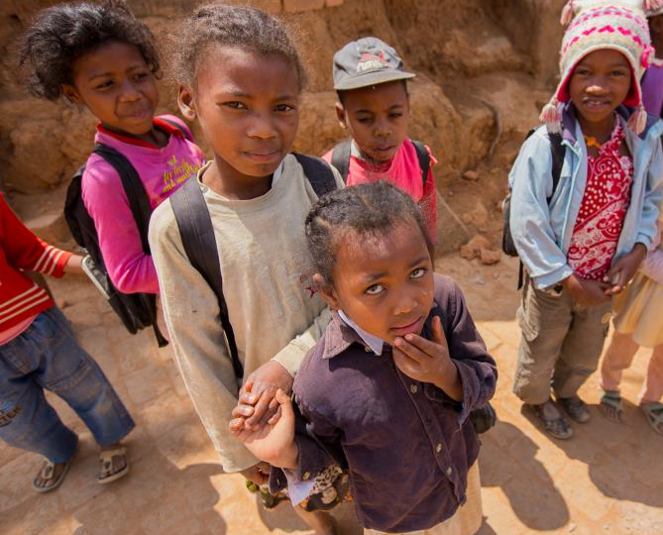
$70/teacher
$120/family
$435/five students
$34,800/school
Notes:
If you need to make it tangible, here’s a thought. You can ask for a gift at any of the below dollar amounts that could support these outcomes.
Teacher training: will cost approx $70 to train one teacher
Or
Each family will receive approximately $10/month: you can ask for a gift of $120 to support one family for one year
Or
Catch-up classes will cost $435 for five students
Or
School construction: this element of the program will cost $34,800 per classroom. For some of your high rollers, you can place their support in this context or ask people to support a certain portion of each school
Can be other examples based on project budget.
All of these are of course exemplary and please remember that the donor’s dollar won’t go directly to that element

Slide 27
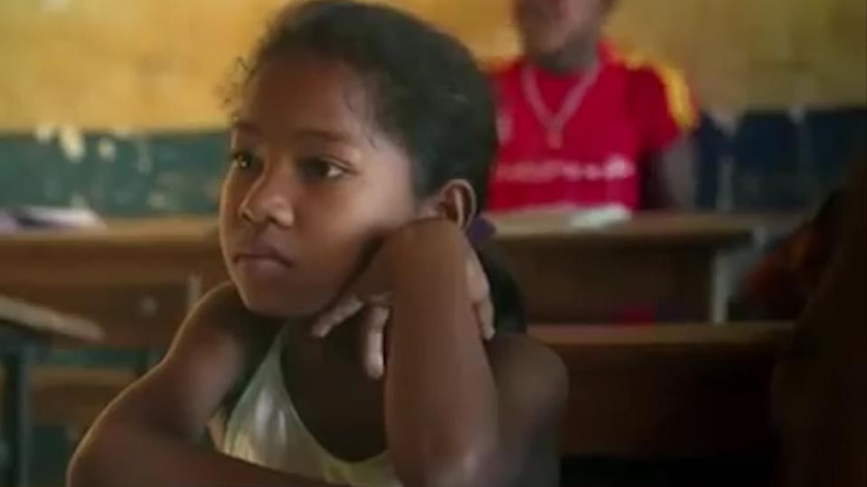
Notes:
Let me close by coming back to Latonirina
By now you understand the many different barriers she faces every single day
But thanks to Let Us Learn, she’s overcoming these barriers and staying in school- and most importantly, she’s motivated to do so
When someone asks her, “Why should girls go to school,” she says “If boys go to school, why can’t girls go too?”

Slide 28
Thank you!
Questions?
Rachel Steinberg, rsteinberg@unicefusa.org
Notes:
Questions?

