Slide 1
CEDAW in the USA
Mary Vacanti, Pati Aine Guzinski

Slide 2
The Convention on the Elimination of all Forms of Discrimination Against Women
CEDAW

Slide 3
Agenda
What is CEDAW?
II. What is Cities for CEDAW? Why now?

Slide 4
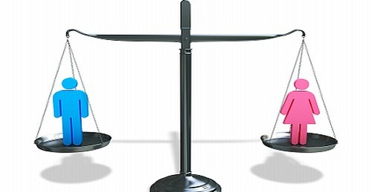
WHAT IS CEDAW?
An international human rights agreement
Address the rights of women and girls
Defines human rights principles, concepts and related standards of conduct and obligation
Parties to the Convention make arrangements to ensure that women and girls actually experience equality… not just words

Slide 5
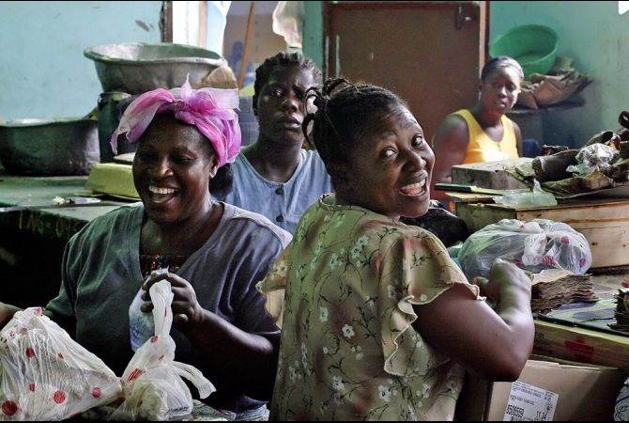
WHY IS CEDAW IMPORTANT?
Sole international legal instrument specifically designed to promote and protect women’s rights
Provides a complete definition of discrimination
Legally binds all State Parties that sign and ratify
Addresses gender inequalities in all spheres and levels: family, community, market and state
Requires State parties to eliminate prejudices and customary and all other practices that obstruct women’s development

Slide 6
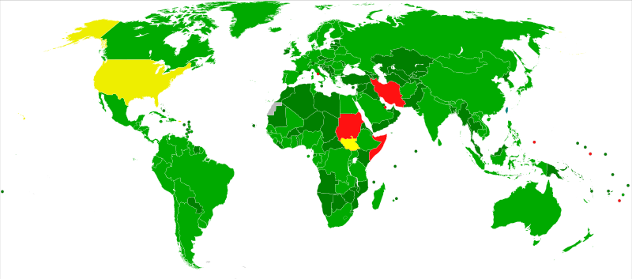
HISTORY
Adopted by UN General Assembly 12/18/1979
Presented to member states for signatures
Came into force 9/3/1981
Seven UN member states have not ratified or acceded:
Iran, Somalia, Sudan, South Sudan, Palau, Tonga and…
The United States !

Slide 7
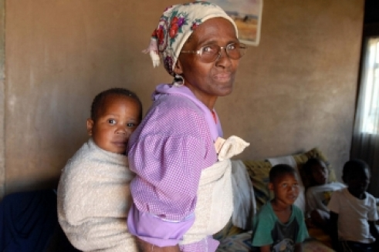
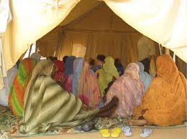
THREE MAIN PRINCIPLES
Substantive equality
Non-discrimination
State obligation
Each principle distinct element in itself
They are also interdependent
Together = holistic framework to achieving women’s rights

Slide 8
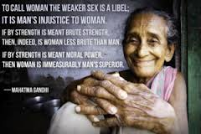
SUBSTANTIVE EQUALITY
Equality of opportunity
Equality of access
Equality of benefits and results
Requires gender analysis on differences between men and women
Must understand underlying assumptions about differences
Social and cultural norms
Mistaken beliefs
Prejudices
Political structures

Slide 9
NON-DISCRIMINATION
Member states must ensure women are not at a disadvantage due to biological, physical and physiological attributes or because of cultural and social norms
Direct discrimination: Action that intentionally treats women differently and subordinates them
Indirect discrimination: Not intentional but the action blocks women’s access to opportunity or denies her rights

Slide 10
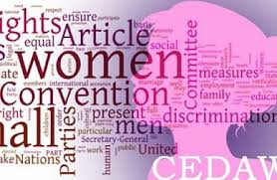
STATE OBLIGATION
States that ratify commit to:
End all forms of discrimination against women
Incorporate equality in the legal system, end discriminatory laws and adopt laws promoting gender equality
Establish institutions to ensure effective protection of women
Ensure private persons, groups and enterprises promote and protect women’s rights.

Slide 11
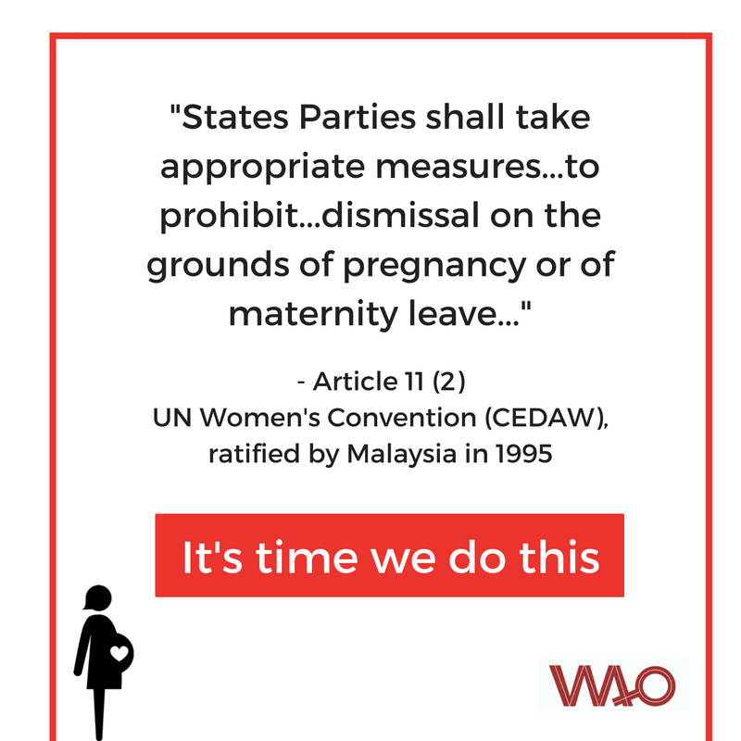
ARTICLES
Definition of discrimination
Policy measures
Guarantee of basic human rights/fundamental freedoms
Special measures
Sex role stereotyping and prejudice
Trafficking and prostitution
Political and public life
Participation at the national level
Nationality
Education
Employment
Health care and family planning
Economic and social benefits
Rural women
Equality before the law

Slide 12
IN A NUTSHELL, CEDAW SEEKS TO:
End sex trafficking, domestic abuse, violence against women
Provide access to education/vocational training
Ensure the right to vote
Improve maternal health care
Ensure ability to own a business without discrimination
Ensure inheritance rights
End forced marriage and child marriage
Ensure economic equality

Slide 13
ENFORCEMENT
Reports submitted 1 yr. after ratification & every 4 yrs. After
CEDAW Committee meets to examine reports
Examination of State in form of constructive dialogue
CEDAW Committee issues Concluding Observations
States are required to implement the Concluding Observations
Optional Protocol provides a way for individuals or groups within a State to seek redress directly from CEDAW Committee

Slide 14
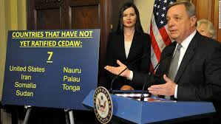
CEDAW IN THE U.S.
Only industrialized country that has not ratified
U.S. active in drafting in 1979
Signed by President Carter in 1980
Senate Foreign Relations Committee must approve ratification by a 2/3 vote
Over 190 religious, civic and community groups support, including Zonta
Not ratified due to party politics and misconceptions

Slide 15
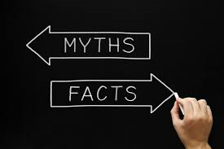
MISCONCEPTIONS
The treaty encourages abortion by promoting access to “family planning”
CEDAW is un-American, violates U.S. sovereignty and federalism.
CEDAW will force unisex bathrooms, legalization or prostitution, and force women into combat positions
Allow and promote a flood of lawsuits
CEDAW would mean the end of Mother’s Day

Slide 16
MISCONCEPTIONS
Require U.S. to implement quota systems for elections and government jobs
CEDAW would harm women and children, by attacking and destroying healthy roles of men and women
Harm marriage, families, and religious faith
CEDAW based on erroneous premise—differences b/t men and women are innate, not “discrimination”

Slide 17
If CEDAW doesn’t do all that, what does it do?

Slide 18
City CEDAW Resolutions
Ashland (OR)
Buffalo (NY)
Cincinnati (OH)
Daly City (CA)
Edina (MN)
Eugene (OR)
Lafayette (CO)
Laguna Woods (CA)
Louisville (KY)
Minneapolis (MN)
New Orleans (LO)
Kansas City (MN)
Portland (OR)
Salt Lake City (UT)
Santa Monica (CA)
St. Paul (MN)
St. Petersburg (FL)
Tampa (FL)
University City (Missouri)
West Hollywood (CA)
Kentucky (State)
Oregon (State)

Slide 19
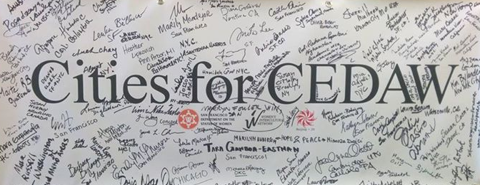
City CEDAW Ordinances
1998 San Francisco (Women’s Human Rights Ordinance)
2004 Los Angeles
2012 Berkeley
[2014 National Cities for CEDAW Campaign]
[2015 Los Angeles – Executive Directive (Mayor Garcetti)]
2015 Miami Dade County
2015 Honolulu
2016 Washington, DC
2016 Pittsburgh
Up Next: 2017 Buffalo!

Slide 20
Achievements – San Francisco
Record 44 months without a Domestic Violence Homicide (cross-agency approach)
Gender Equality Principles Initiative—mainstream through public and private sector employment
Developed Proper Police Codes—Domestic violence, stalking, child abuse, elder abuse
Expanded Language Access—trained 150 emergency personnel in basic Chinese & Spanish; provide cell phones to access 170 different languages at crime scenes
Gender Analysis of City Agencies

Slide 21
Achievements – San Francisco
Street light program—in response to women having difficulty securing early-morning street vending licenses
New Detention/Probation Protocols for Juvenile Girls
Family Friendly Workplace Ordinance—right to request flexible/predictable work schedule w/o fear of retaliation
Family Violence Council
San Francisco Collaborative Against Human Trafficking
Mayor’s Task Force on Human Trafficking
Violence Against. Women Prevention and Intervention Grants Program—grants totaling $4.6 million to 31 community-based programs

Slide 22
What Can You Do?

Slide 23
What Can You Do?
Join our campaign
As a supporter
As a Steering Committee Member
Organize groups you are involved with to become institutional sponsors
Sign a Petition

Slide 24
What Can You Do?
Organize a Petition-signing Event
Community event
Church
Huddle

Slide 25
What Can You Do?
Record a Testimonial
Why Buffalo Needs a CEDAW Ordinance
Why is gender equality important to you
Organize others to record testimonials

Slide 26
What Can You Do?
Write an Op-Ed
Talk to Friends and groups
Offer your special skills
Tech/website
Editing
Organizing, etc.

Slide 28
QUESTIONS

