Slide 1
Where it all began
A feature on Marian de Forest
Buffalo, New York, USA
Special thanks to Vivian Cody, member of the Zonta Club of Buffalo, NY, USA, past Zonta International Director and District 4 Governor, and 2012-2014 Centennial Anniversary Committee member

Slide 2
Marian de Forest
Marian de Forest was an extraordinary woman who contributed greatly to the Buffalo community.
A Buffalo native, she worked as a reporter, drama critic, and editor of the women’s department of the city newspaper.
She was also a playwright best known for writing and producing Little Women, based on the Louisa May Alcott novel.
She was instrumental in bringing music to the children of Buffalo through the Buffalo Music Foundation which she co-founded.
Marian was the executive secretary of the Board of Women Managers for the Women’s Pavilion for the 1901 Pan American Exposition in Buffalo.
Marian is universally acknowledged as the Founder of Zonta, in 1919.

Slide 3
The Founders
Delegates from the nine Charter Clubs who met in Buffalo, New York at the Statler Hotel on 8 November 1919

Slide 4
The Statler Hotel
The Statler Hotel was the home of the Zonta Club of Buffalo until 1990 when it became the Statler Towers office building.

Slide 5
Statler Plaque

Slide 6
Club #001- Buffalo, NY Certificate of Acceptance

Slide 7
Marian de Forest Remembered by her Community
In the following sequence of images,
we highlight Marian de Forest’s
life and legacy in Buffalo

Slide 8
Marian de Forest: Remembered by her Community
The numbers in brackets [#] refer to the sites detailed on the following slides, to guide you if you visit Buffalo
Marian de Forest was an extraordinary woman dedicated to improving the quality of life of the Buffalo community. Her family lived on Oak Street [4] while she was growing up, and as an adult she lived in the heart what is now the Allentown community at 30 Irving Place [7].
She went to school at Buffalo Seminary [10], worked at the Buffalo Express [6], was involved in the founding of the Buffalo Philharmonic [8], and a member of the Boards of the SPCA and Eric County Library Association [3].

Slide 9
Marian de Forest: Remembered by her Community
The numbers in brackets [#] refer to the sites detailed on the following slides, to guide you if you visit Buffalo
Marian de Forest was also a player in events beyond Buffalo, NY. She was the author of the play Little Women (still produced today, [5]) and the Executive Secretary of the Board of Women Managers of the Pan American Exposition in 1901 [11]. She is best known for the founding in Buffalo, NY [2] of Zonta International, a women's professional service club which has become a world wide organization with over 30,000 members in 1200 clubs in 66 countries.

Slide 10
Marian de Forest: Remembered by her Community
The numbers in brackets [#] refer to the sites detailed on the following slides, to guide you if you visit Buffalo
Marian de Forest was inducted into the Western New York Women's Hall of Fame in 1998 and the National Women's Hall of Fame in Seneca Falls, NY in 2001. She was the inspiration behind the Larry Griffiths, Jr. statue Spirit of Womanhood in Delaware Park [12] and is prominently featured in the Women's Walkway [1], a cobblestone path commemorating 100 Women from Western New York. Marian de Forest is buried in Forest Lawn Cemetery [9].

Slide 11
Sites Honoring Marian de Forest
These sites are grouped by area. Those in bold type represent areas in which current Buffalo shows a direct link to her; while the places which were built after her death, or where Buffalo is currently different from her lifetime, are shown in normal type. Places are listed from the Waterfront moving north to the Museum District.
DOWNTOWN
Women's Walkway - located at the NFTA DL&W Terminal site adjacent to HSBC Arena on the Buffalo Waterfront.
Statler Towers - 107 Delaware Avenue. The plaque near the entrance commemorates the founding of Zonta International.
Main Library Erie County and Buffalo - Lafayette Square
36 Oak Street - Oak Street is 1 block east of the Library and is now developed for industrial use. The de Forest family home is no longer there.
Theater place - Main Street between Tupper and Chippewa is the center of the Buffalo Theater District today.
Courier Express building- 765 Main Street, North of Tupper. Built in 1930 to house the Courier Express formed from the Buffalo Express and Courier.

Slide 12
Sites Honoring Marian de Forest
ALLENTOWN
30 Irving Place - The house is no longer there, but the neighborhood still has the same feel as when Marian de Forest lived there.
Kleinhans Music Hall - located at Symphony Circle off North Street at Richmond Ave. The current home of the Buffalo Philharmonic was designed by the Saarinen brothers and built between 1938 and 1940.
MUSEUM DISTRICT
9. Forest Lawn Cemetery - Enter from Delaware Ave near Delavan Ave – Marian de Forest’s grave is in Section 1, D6.
Buffalo Seminary - 205 Bidwell Pky near Soldiers Park.
Buffalo Historical Society - 25 Nottingham Ct. Only remaining building from the 1901 Pan Am Exposition.
Spirit of Womanhood - Located in Delaware Park between the North side of the path around Hoyt Lake and Route 198. Larry Griffiths, Jr., Artist.
(Dr. Gail R. Willsky and Dr. Vivian Cody, Zonta Club of Buffalo).

Slide 13
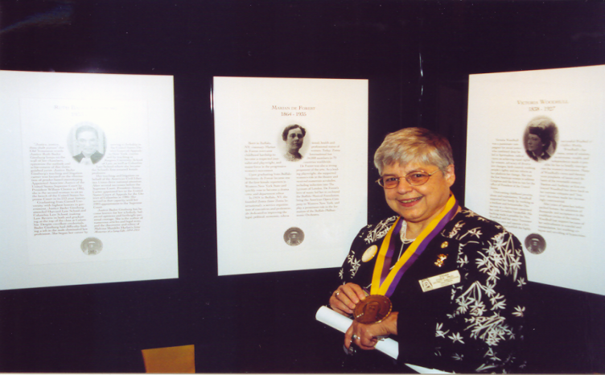
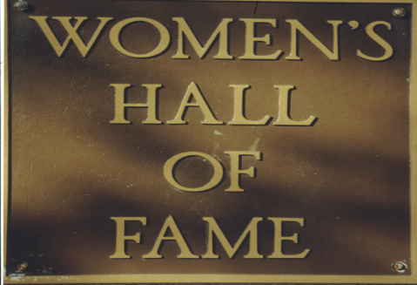
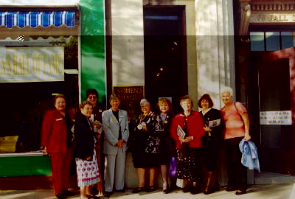
Induction to National Women’s Hall of Fame
Past District 4 Governor Vivian Cody accepts medal for Marian de Forest
District 4 Zontians at Hall of Fame

Slide 14
Marian de Forest: A Woman Who Made the Impossible Possible
Display panels about Marian de Forest presented by the Zonta Club of Buffalo at a symposium during the PanAM 100th anniversary celebration in 2001.

Slide 15
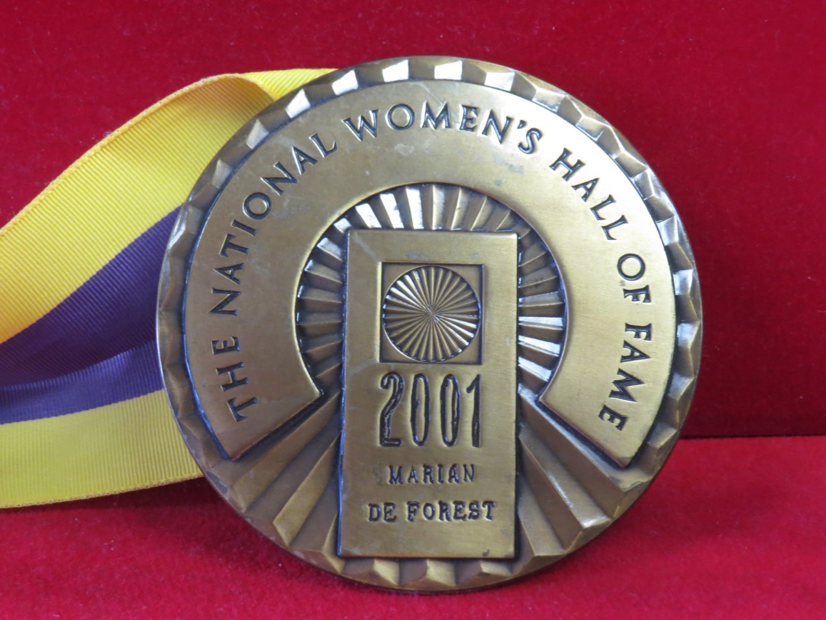
National Women’s Hall of Fame medal
The Marian de Forest medal is one of Zonta International's treasured artifacts in the office suite in Oak Brook, Illinois

Slide 16
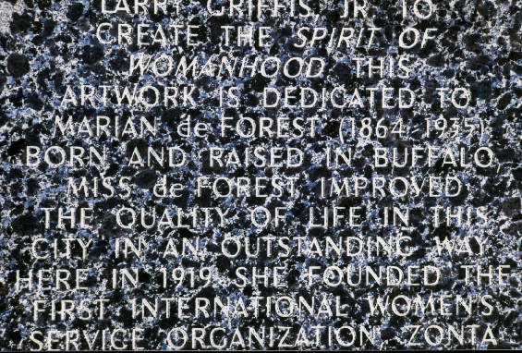
The Spirit of Womanhood
Delaware Park, Buffalo, NY September 6, 2002
Dedicated to Marian de Forest, founder of Zonta International. Supported by Women’s Pavilion Pan Am 2001, Inc. and District 4 Zonta International.

Slide 17
Her Legacy
Zonta International, continuing the vision: women helping women to improve their quality of life
Inspiration for “Spirit of Womanhood”
Marian de Forest Community Service Award in Buffalo
Honoring Zonta Service
President-elect Mary Ellen Bittner with Helen Duffin from the D4 Hamilton I Club, Hamilton, ON, Canada, on the 75th anniversary of the Hamilton I Club March, 2003. District 4 display highlighting Zonta

Slide 18
Where it all began
A feature on Marian de Forest
Buffalo, New York, USA
Compiled by Kate Trusk Edrinn, ZI Staff Archivist, March 2014.

