Slide 1
Unleashing the Power of Media
Working for Women through Media
Monica J. de la Cerda, MBA
PR and Communications Committee
Zonta International

Slide 2
Relevant Media to Maximize Efforts
Search Engine Optimization (SEO) and Organic Content

Slide 3
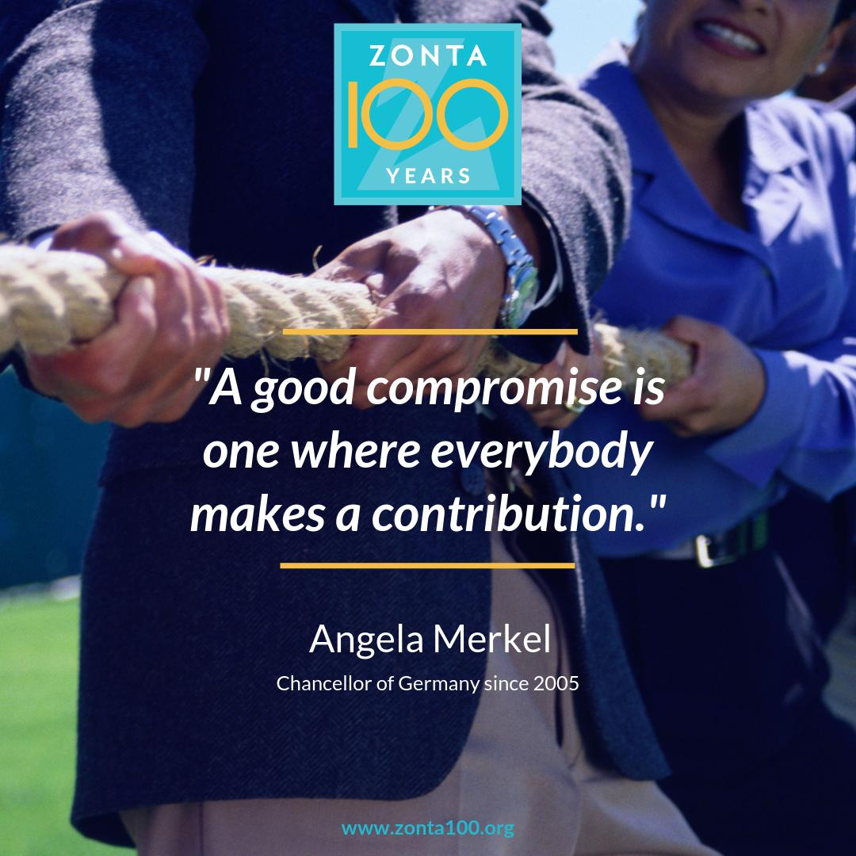

Slide 4
Earned Media Coverage
Stories to gain interest from media and expanded networks

Slide 5
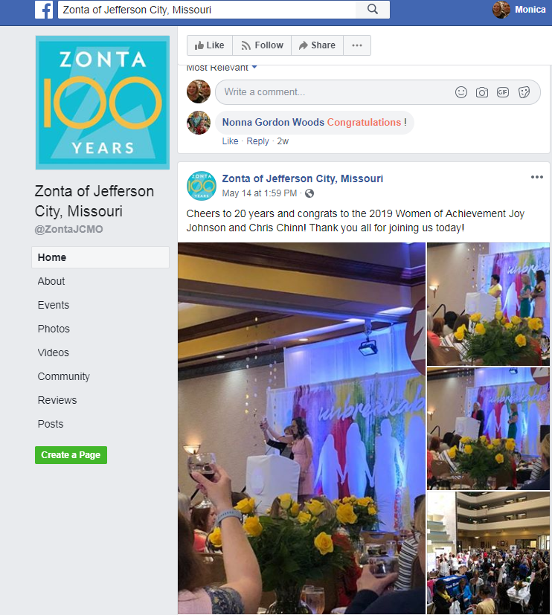
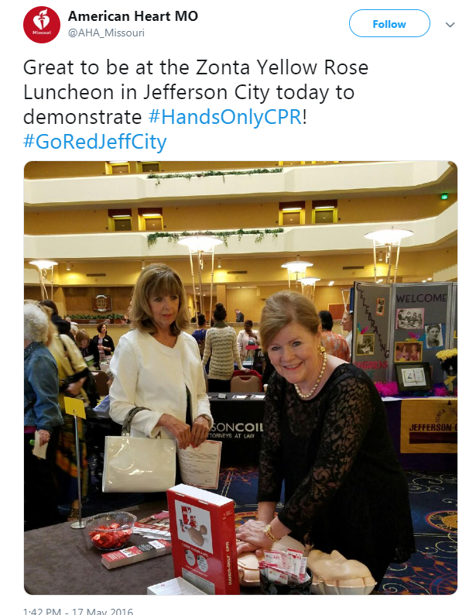
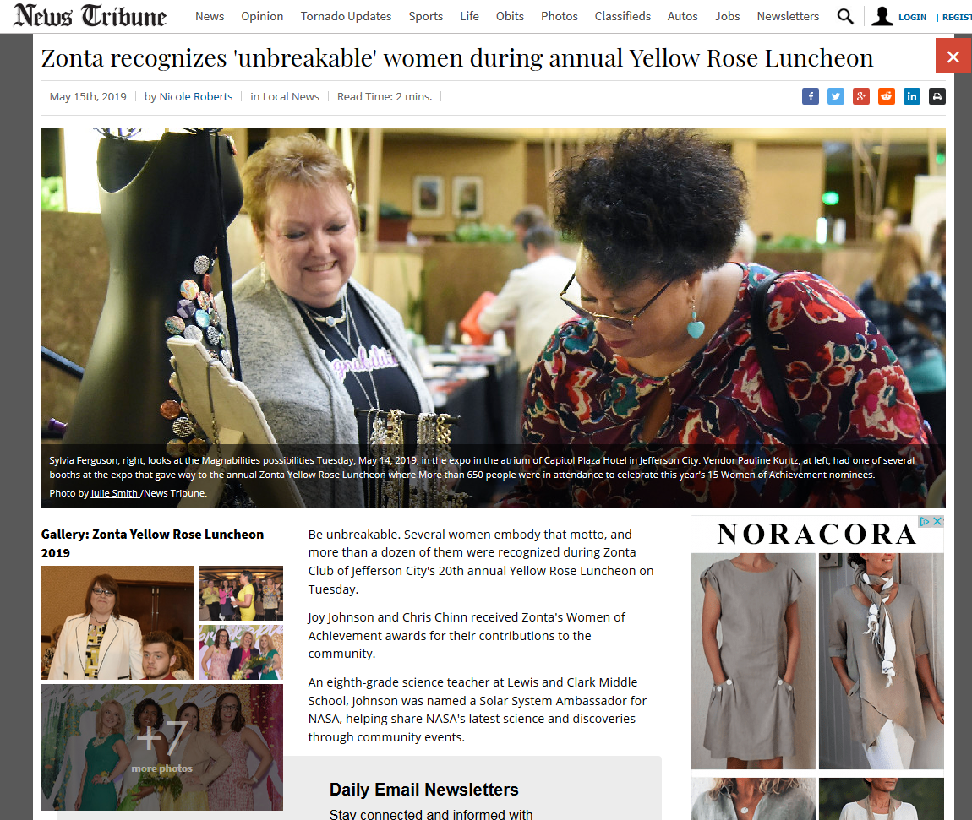
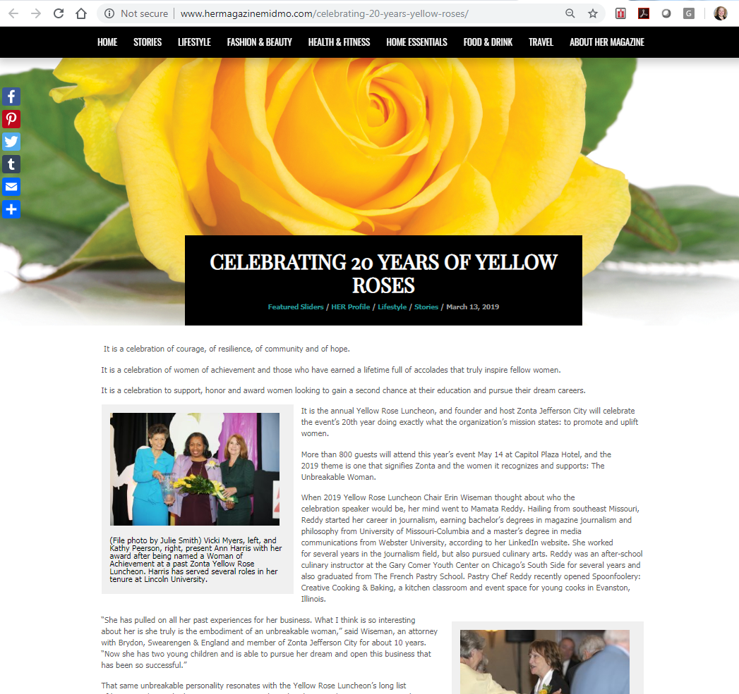
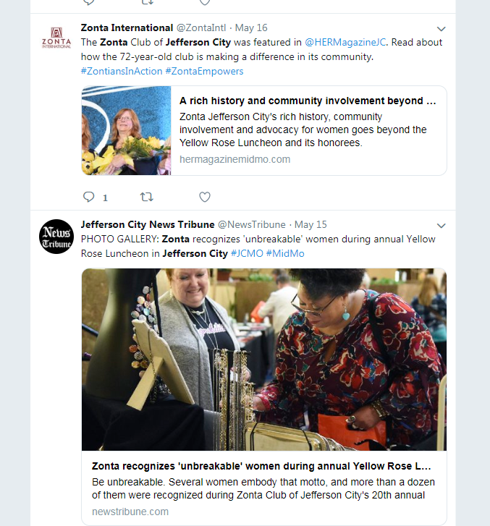

Slide 6
A Built-in Network
The natural power of our size and footprint

Slide 7
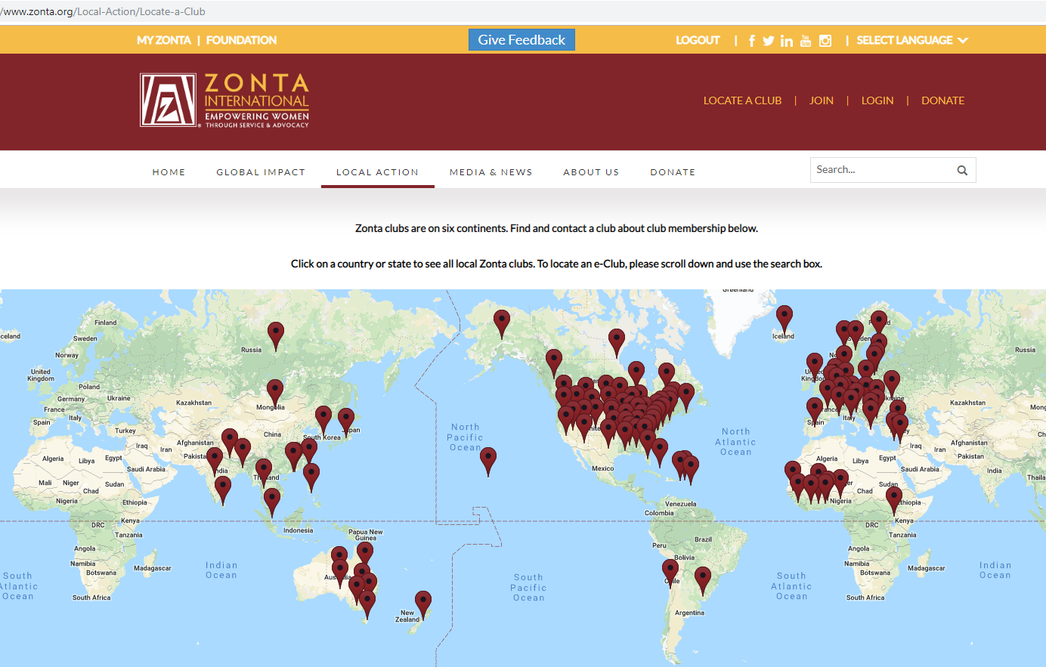

Slide 8
Every Drop Counts
Every member can make their voice count

Slide 9
